Slide 1
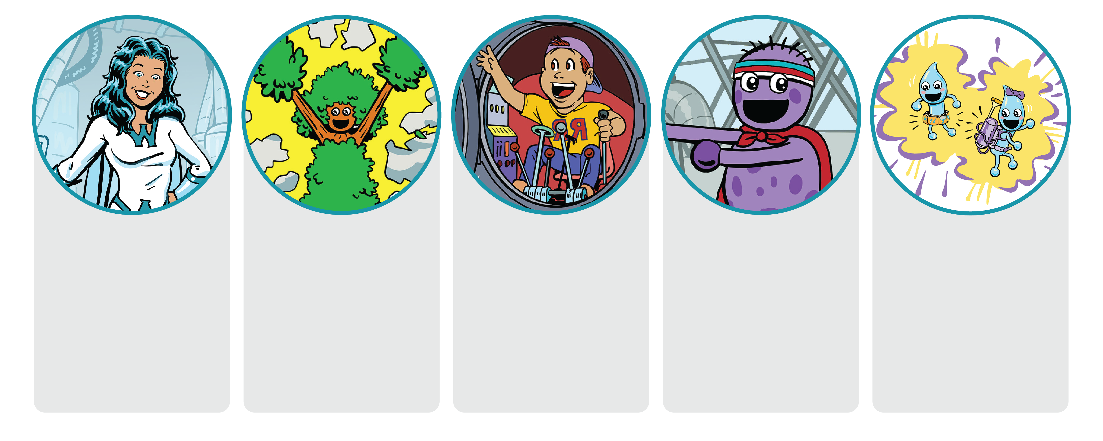
PROGRAM OVERVIEW
Read:
Chapter 1
Lesson:
Let’s Build a Water Pipeline
Bonus Activity: Westie’s Amazing Message Maze
Read:
Chapter 2
Lesson:
The Water Cycle
Bonus Activity: Mother Earth’s Color Time
Read:
Chapter 3
Lesson:
Role of Plants in Water Filtration
Bonus Activity: Circle with Sal and Ozzy
Read:
Chapter 4
Lesson:
How to Save and Protect Water
Bonus Activity: Save Water with Anna Robic Worksheet
Read:
Chapter 5
Lesson:
How to Save Water Commercials
Bonus Activity: Spread the Word Madlib

Slide 2

Lesson #1:
Let’s Build a Water Pipeline

Slide 3


Let’s Discuss!
How does water from rivers or lakes get to your home?

Slide 4
Drawing Activity
Draw a picture of your home with the pipes that carry water into your home.

Slide 5
Hands-On Activity
Let’s build a water pipeline!

Slide 6
Let’s Discuss!
What did you notice as the pipeline became longer?
What happened if the tape didn’t make an airtight seal?
Did any groups have a water leak? How did you fix the problem?
How would this activity change if the straws were bigger or smaller around?

Slide 7

Fun Water Fact
Seventy-five percent (75%) of the human brain is water and 75% of a living tree is water.

Slide 8

Water Conservation Jobs
Pipelayer
Pipelayers place pipes outdoors. They install large-diameter pipes, such as water mains, or smaller pipes that carry water from the main to houses or buildings. Pipelayers may also install sewage systems that carry waste to treatment plants. The pipes must also be protected and reinforced before the ground covers them.
Annual salary (mean): $48,510 per year
Engineer
Engineers design, coordinate and manage utility projects. They also gather and compile data and prepare designs, plans, details, estimates and specifications for construction of those projects.
Annual salary (mean): $140,000 per year

Slide 9
Activity Sheet
Westie’s Amazing Message:
Find your way through the maze and write the letters in the order they appear on the lines below. Read the sentence out loud once you’ve completed it.

Slide 10
Lesson #2:
The Water Cycle

Slide 11

Let’s Discuss!
What are some ways we use water?

Slide 12
Drawing Activity
Draw a picture of one of the ways we use water.

Slide 13
The Water Cycle

Slide 14
Hands-On Activity
Let’s build a water cycle!

Slide 15
Let’s Discuss!
Where is water collecting?
Why is it collecting there?
What happens to the water after it evaporates?

Slide 16

Fun Water Fact
There is the same amount of water on Earth as there was when the Earth was formed. The water from your faucet could contain molecules that dinosaurs drank.

Slide 17
Water Conservation Jobs
Environmental Scientist
Environmental scientists protect natural water sources from pollutants and other contamination by studying the sources and effects of pollution. They figure out ways to clean sources up and prevent further pollution.
Annual salary (mean): $96,820 per year
Water Resource Specialist
Water resource specialists perform planning and research related to water demand and conservation, groundwater management, water supply planning and other water resources tasks. They also analyze data, conduct grant management and customer support activities, and research and prepare reports.
Annual salary (mean): $110,000 per year

Slide 18
Activity Sheet
Mother Earth’s Color Time:
Color the picture of the water cycle and hang your work where friends and family will see it.

Slide 19
Lesson #3:
Role of Plants in Water Filtration

Slide 20
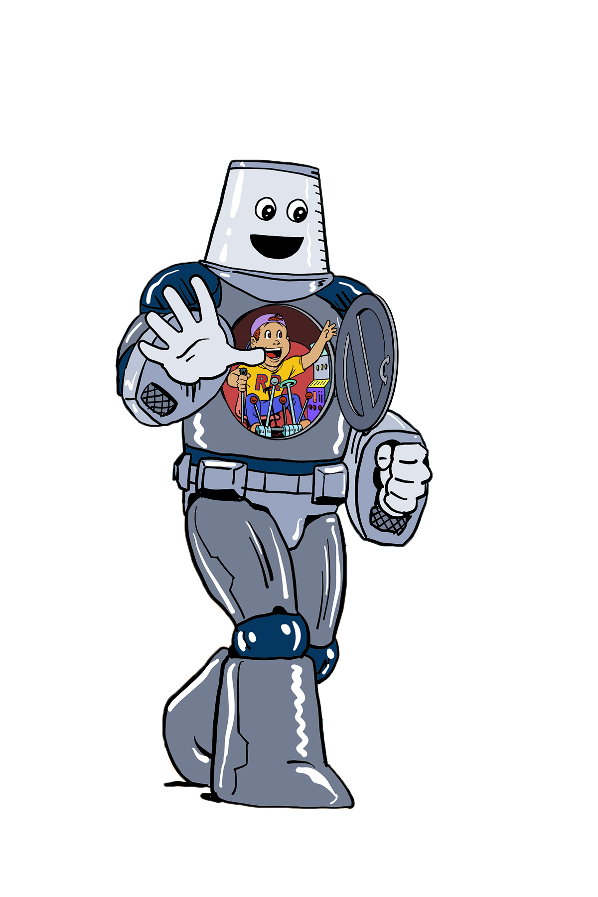
Let’s Discuss!
What do we know about how plants and flowers grow?

Slide 21
Drawing Activity
Draw a picture of your favorite plant or flower.

Slide 22
Hands-On Activity
Let’s do a water filtration experiment!

Slide 23
Let’s Discuss!
In what ways can plants and soil benefit drinking water quality?
Can plants and soil remove any type of impurity from water?
What is the role of rainwater moving through contaminated soil?

Slide 24

Fun Water Fact
Nearly 97% of the world’s water is salty or otherwise undrinkable. Another 2% is locked in ice caps and glaciers. That leaves just 1% for all of humanity’s agricultural, residential, manufacturing, community and personal needs.

Slide 25
Water Conservation Jobs
Farmer
Farmers oversee the growing of crops. They supervise all steps of crop production, including planting, fertilizing, watering and harvesting. They determine how to raise crops, including the amount of water needed and the most efficient way to deliver crops to the communities who use them.
Annual salary (mean): $73,060 per year
Water Treatment Operator
Water treatment operators add chemicals, such as ammonia or chlorine, to disinfect water or other liquids. They also inspect equipment on a regular basis, operate equipment to purify water and ensure safety standards are met.
Annual salary (mean): $47,880 per year

Slide 26
Activity Sheet
Circle with Sal and Ozzy:
Circle the plants and animals in the ecosystem.

Slide 27
Lesson #4:
How to Save and Protect Water

Slide 28

Let’s Discuss!
Brainstorm different ways we use water.

Slide 29
Hands-On Activity
Let’s make a water saving plan!

Slide 30
Let’s Discuss!
How can our class save water around the school?
What items in the school can be recycled?

Slide 31

Fun Water Fact
Water is part of a deeply interconnected system. What we pour on the ground ends up in our water, and what we spew into the sky ends up in our water.

Slide 32
Water Conservation Jobs
Industrial Engineer
Industrial engineers are involved with improving industrial practices and increasing efficiency. They devise ways to use less water more efficiently. They may design systems that contain or cleanse water that has become contaminated through industrial processes.
Annual salary (mean): $95,300 per year
Water Conservation Specialist
Water conservation specialists assist in the development, implementation and monitoring of conservation programs, serve as technical experts on water efficiency issues, evaluate opportunities for public involvement and community networks, research water conservation programs and techniques, and prepare recommendations for overall program objectives and goals.
Annual salary (mean): $58,000 per year

Slide 33
Activity Sheet
Save Water with Anna Robic:
Name one way to save water indoors and one way outdoors. Draw a picture of each.

Slide 34
Lesson #5:
How to Save Water Commercials

Slide 35
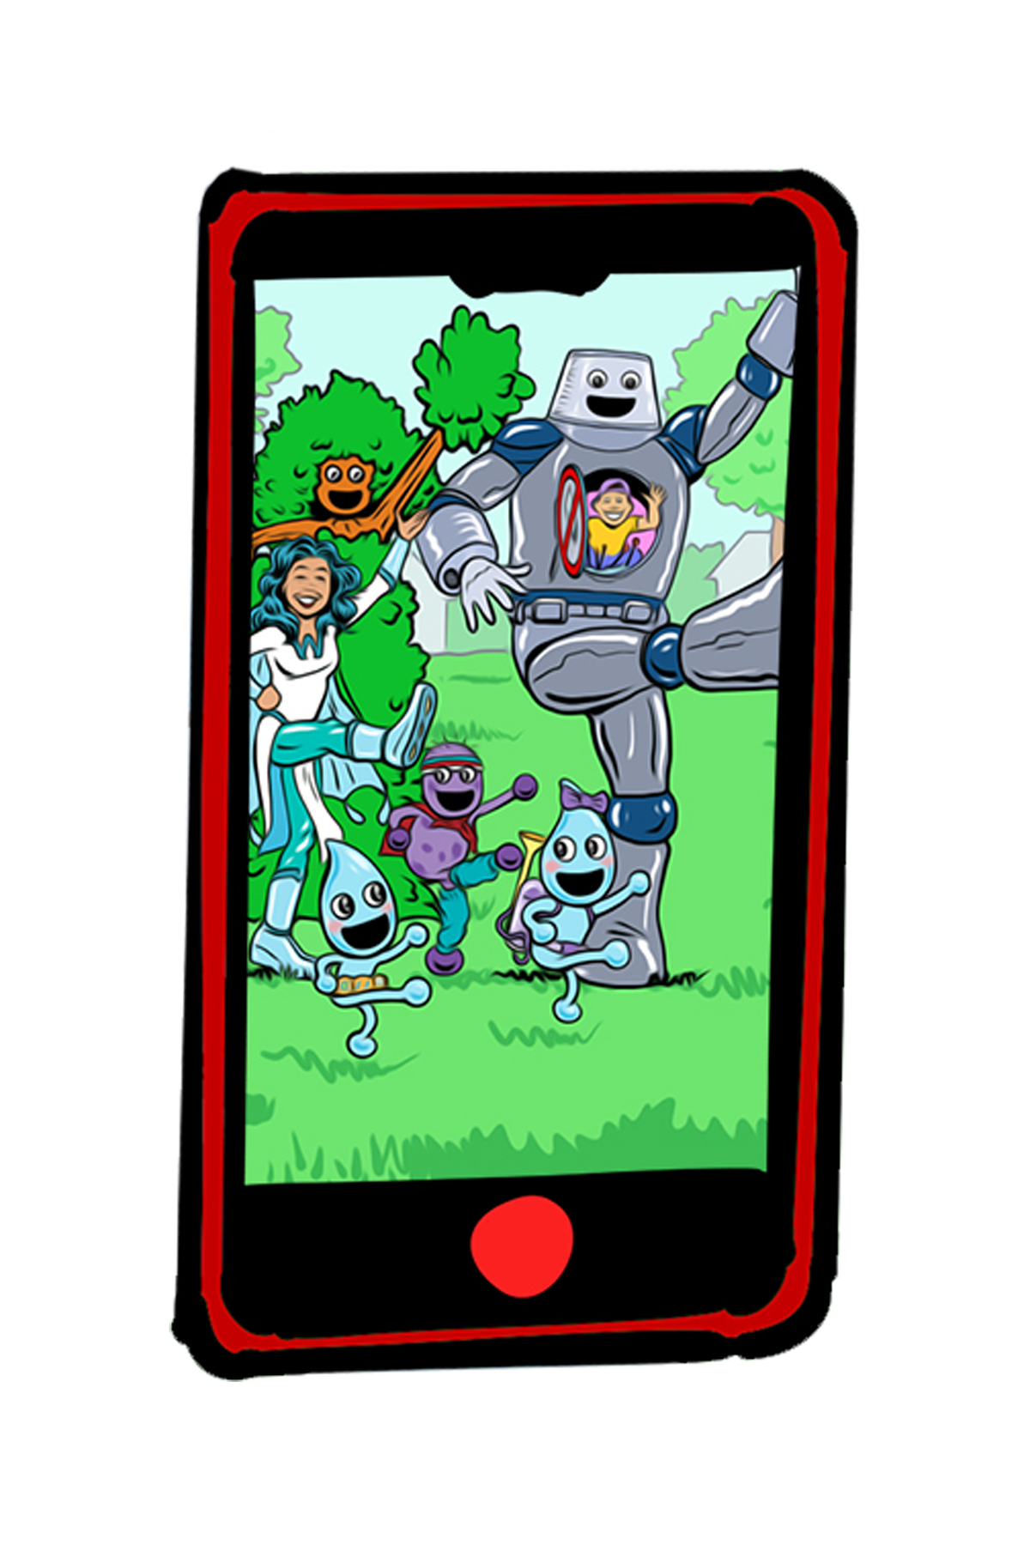
Let’s Discuss!
What are your favorite commercials? Why?

Slide 36

Example Commercials

Slide 37
Persuade
to move by argument, entreaty or expostulation to a belief, position or course of action
to plead with or urge
How do we persuade people?
Merriam-Webster. (n.d.). Persuade. In Merriam-Webster.com dictionary. Retrieved March 28, 2023, from https://www.merriam-webster.com/dictionary/persuade

Slide 38
Water Saving Suggestions
Don’t leave the water running while brushing teeth.
When washing your bike or the family car outdoors, make sure to use a hose equipped with a shut-off nozzle.
Keep brainstorming ideas!

Slide 39
Plan Your Commercial
Draw the beginning, middle and end.
Try acting out these scenes with dialogue.
Keep practicing your commercial.

Slide 40

Fun Water Fact
The average total home water use for each person in the U.S. is about 50 gallons a day.

Slide 41
Water Conservation Jobs
Landscape Architect
Landscape architects plan and design land areas for parks, recreational areas, highways and other properties. They may practice xeriscaping to choose the type and quantity of plants for a landscaped area. Part of their job is to determine how much water their landscapes require and to plan ways to ensure that the land is properly watered and drained.
Annual salary (mean): $67,950 per year
Communication Specialist
Communication specialists perform customer outreach, oversee district and community events, manage stakeholder databases, and serve as liaisons with external and internal groups.
Annual salary (mean): $74,000 per year

Slide 42
Activity Sheet
Spread the Word:
Fill in this story and read to your friends.

Slide 43
FUN WITH WATER JOBS

Slide 44
Drawing Activity
Choose your favorite water job you learned about this week and imagine what a person may look like performing that job.
Draw what you imagined!

